Slide 1

Employee Attrition
Sashidhar Bezawada

Slide 2
Agenda
What is Employee Attrition?
Dataset: IBM - Employee Attrition & Performance
Variable Histograms
Comparing Two Scenarios Using a PMF
Hypothesis Testing
Regression Analysis

Slide 3

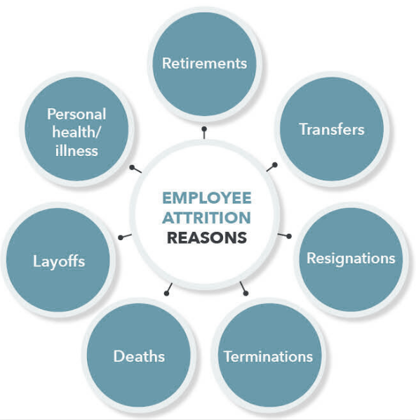
What is Employee Attrition?
Definition : “When an employee leaves the company through any method, including voluntary resignations, layoffs, failure to return from a leave of absence, or even illness or death”
Two types of employee attrition:
Voluntary
Employee deliberately chooses to leave their company
Company has the decision to not replace the employee
Involuntary
The company chooses to let go of (fire) an employee
EX) Reorganization, layoffs
In this case, the company either eliminates the employee’s position altogether or chooses not to replace it
https://www.digitalhrtech.com/employee-attrition/

Slide 4
Voluntary Employee Attrition Issues
Definition : “When an employee leaves the company through any method, including voluntary resignations, layoffs, failure to return from a leave of absence, or even illness or death”
Two types of employee attrition:
Voluntary
Employee deliberately chooses to leave their company
Company has the decision to not replace the employee
Involuntary
The company chooses to let go of (fire) an employee
EX) Reorganization, layoffs
In this case, the company either eliminates the employee’s position altogether or chooses not to replace it

Slide 5
As a current employee at a company, I have started to take note of what motivates and what deters other employees. Many things play into people’s decisions to leave a company, and it is intriguing to me to understand what causes movement in the workplace and also how companies can ideally increase their employee retention at the end of the day.
Statistical Question:
What factors play a significant role in predicting voluntary employee attrition?

Slide 6
Dataset: IBM - Employee Attrition & Performance
Employee survey from IBM, a technology corporation
Gathered information around employee satisfaction, income, job level and some personal demographic data such as age and gender
Dataset structure:
1470 rows of data
35 columns
Each record in the dataset pertains to an employee that is either currently at IBM or voluntarily left
Attrition = ‘Yes’ or ‘No’
https://www.kaggle.com/pavansubhasht/ibm-hr-analytics-attrition-dataset

Slide 7

Variables Used for Analysis
AGE
Age of the Employee
(Numerical Value)
MONTHLY INCOME
Monthly salary
(Numerical Value)
DISTANCE FROM HOME
The distance from work to home
(Numerical Value)
YEARS IN CURRENT ROLE
Years in the current role
(Numerical Value)
JOB SATISFACTION
Satisfaction with the job
(Numerical Value)
YEARS SINCE LAST PROMOTION
Last Promotion
(Numerical Value)

Slide 8
Variable Histograms

Slide 9
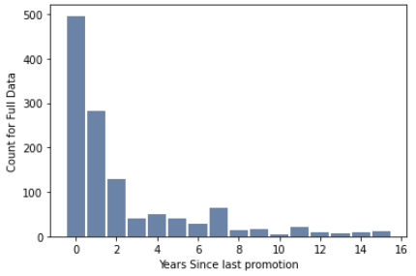
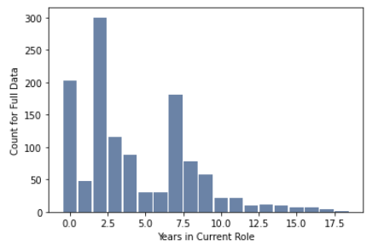
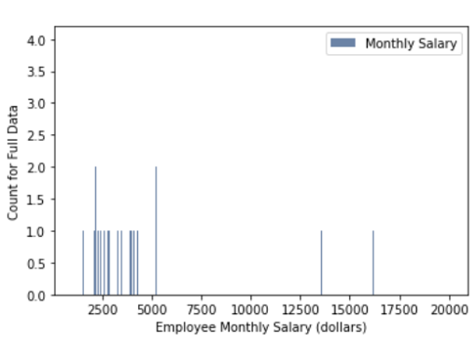
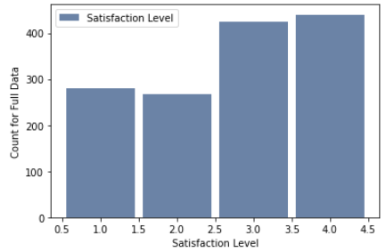
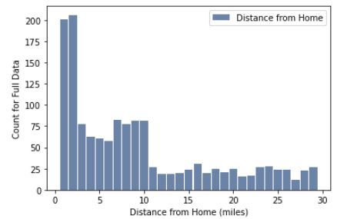
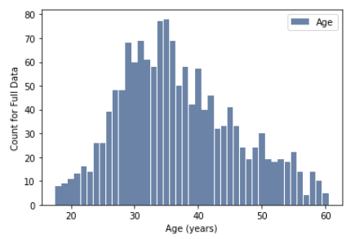
Variable Histograms
YearsSinceLastPromotion
YearsInCurrentRole
MonthlyIncome
DistanceFromHome
JobSatisfaction
Age
- Left-skewed distribution
- Employees who recently got the promotion between 0 to 2 years look for job opportunities outside the company
From the distributions of monthly income and yearly income, it is apparent that there are outlier values for salaries above 100,000 dollars. Depending on your job level and field, this salary range of above $100,000 can be attainable, but I think even with the outliers, salary plays a key role in determining if employees stay at a company.
The distributions for monthly income and yearly income for the entire dataset are the same, which makes sense as yearly income is calculated from the monthly incomes.
- Left-skewed distribution
- Employees between 2.5 years to 7.5 years in current role Look for opportunities outside the company
- Most people are relatively satisfied with their jobs
- Difficult to detect an outlier among only 4 possible values
- Left-skewed distribution
- The IBM office for most employees is relatively close to their homes, less than ~3 miles
- With any company, it is standard for employees to have different commuting distances given the office location
The distribution of age for the entire dataset is relatively left-skewed. From looking at the histogram, it looks like there are outliers from age 18- ~21. Those ages are quite young for employees at a company, as usually companies hire people with undergraduate degrees and most people graduate from college at age 22 or 23.

Slide 10
Analysis of Year Field Histograms
When looking at the year variables, it is tough to say if any entries are outliers, since employees often do and are even supposed to have varying years of experience at a company and within their career. At my company, there are employees with 35+ years, while I have less than a year, so I wouldn't say any of these outliers above the top of the boxplots are out of the ordinary or need to be removed.

Slide 11
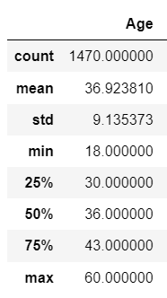
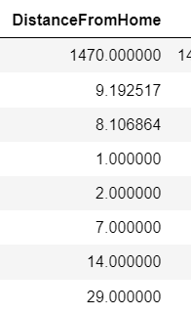
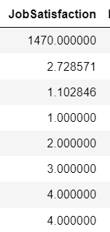
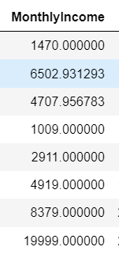
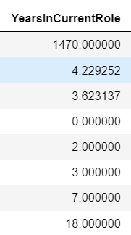
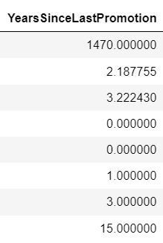
Descriptive Characteristics
Mean, Mode, Spread and Tails
Age
DistanceFromHome
JobSatisfaction
MonthlyIncome
YearsInCurrentRole
YearsSinceLastPromotion

Slide 12
Comparing Two Scenarios Using a PMF
Variable: Years Since Last Promotion

Slide 13
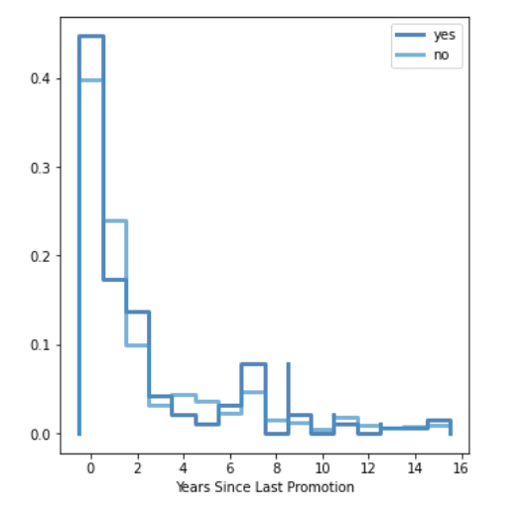
PMF - Years Since Last Promotion
Scenario: An employee participates in voluntary attrition or the employee does not participate in voluntary attrition
Variable: Years Since Last Promotion
The "yes" population goes back and forth among the distribution plot in comparison to the "no" group, there are many fluctuations in probability in terms of Yearly Income.
In trying to find a general pattern, the "yes" group seems to be more likely to have fewer years since their last promotion than the "no" group, which would signify that they are recently in newer positions which could increase work pressure and stress. However, at the greater end of the year scale, the "yes" group is also slightly more likely than the "no" to have those years since their last promotion, which would be quite a long time for someone to be at the same job level, which can be a reason for job movement.
Therefore, this variable is not really helpful in showing how it plays into employee attrition.

Slide 14
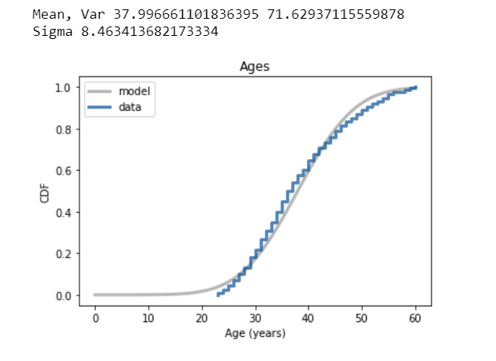
Analytical Distribution - Normal
Below the 10th percentile, there is a discrepancy between the data and the model; there are less young employees than we would expect in a normal distributions. However, this is due to the removal of the younger employees (< age 18) from the dataset, because I considered them to be outliers and just not relevant to a dataset regarding full-time employees choosing whether to leave a company.
Since I am not specifically interested in employees less than the age of ~23, then I am not incredibly disappointed by the use of the normal model for this data/variable.

Slide 15
PMF - Years Since Last Promotion
Scenario: An employee participates in voluntary attrition or the employee does not participate in voluntary attrition
Variable: Years Since Last Promotion
The "yes" population goes back and forth among the distribution plot in comparison to the "no" group, there are many fluctuations in probability in terms of Yearly Income.
In trying to find a general pattern, the "yes" group seems to be more likely to have fewer years since their last promotion than the "no" group, which would signify that they are recently in newer positions which could increase work pressure and stress. However, at the greater end of the year scale, the "yes" group is also slightly more likely than the "no" to have those years since their last promotion, which would be quite a long time for someone to be at the same job level, which can be a reason for job movement.
Therefore, this variable is not really helpful in showing how it plays into employee attrition.

Slide 16
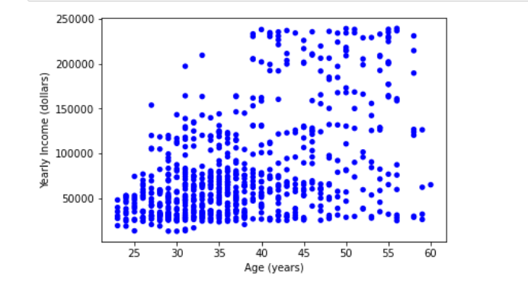
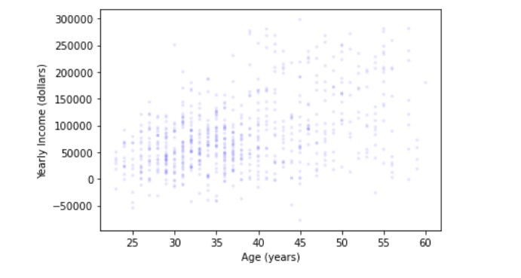
Scatter Plots : Correlation & Causation
Scatter
Jitter

Slide 17
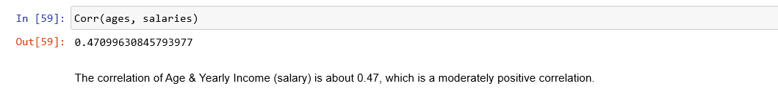
Analysis of Scatter Plots
From initial exploration of the scatter plot between Age and Yearly Income (Salary), there appears to be a positive relationship meaning as the age of an employee increases, their yearly income increases as well (i.e. they start to make more money). The relationship also appears to be linear, as it doesn't seem like any other specific function would fit to the data better than a straight line.

Slide 18
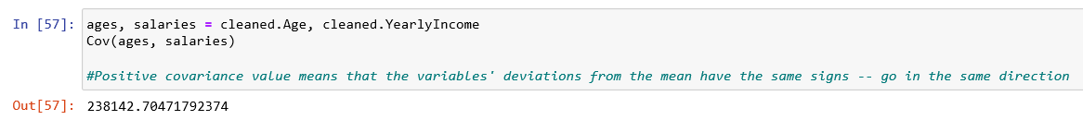
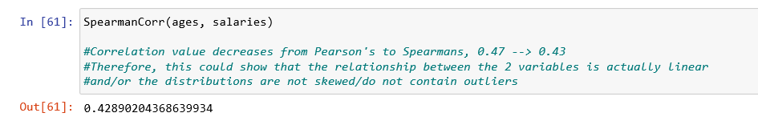
Covariance & Spearman’s Rank

Slide 19
Assessment : Correlation vs. Causation
In terms of the relationship between Age & Yearly Income, even though we witnessed a positive relationship between the two variables, I think there are other factors that cause both Age and Salary, such as years of experience, role at a company, etc. An employee's salary is highly dependent on many factors about an individual and their work performance, but age definitely does have an impact since it aligns with knowledge and expertise and years that one is actually able to work.

Slide 20
Hypothesis
Testing
I want to investigate/test the difference in mean yearly income (salary) that we see between the employees that left the company and the employees that stayed.
I want to know if that effect reflects a real difference for employees in the U.S., or if it might appear in the sample by chance.

Slide 21
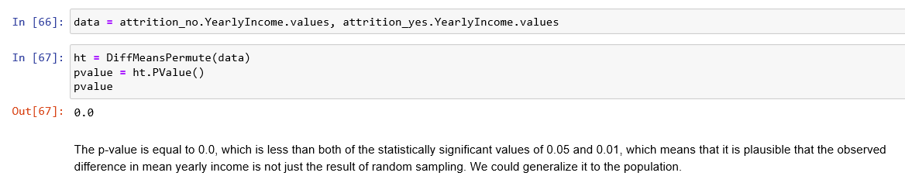
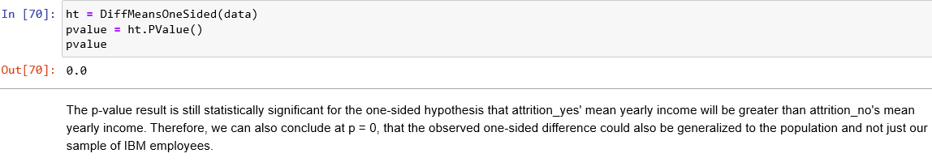
Hypothesis Testing
I would expect that the mean yearly income for people in the non-attrition group is higher than the mean yearly income for people in the attrition group, since I expect people to leave their job in order to make more money somewhere else. Therefore, we can also conduct a one-sided hypothesis test for these means.

Slide 22
Regression Analysis (Logistic Regression)

Slide 23
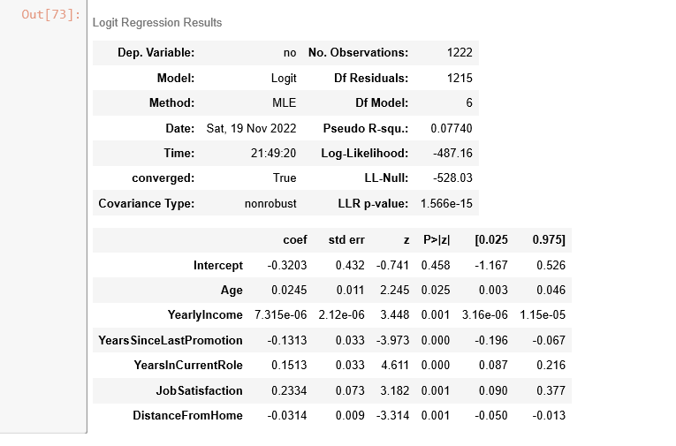
Logistic Regression Results
All variables chosen for exploration were included in the regression –
Age
Yearly Income
Years Since Last Promotion
Years in Current Role
Job Satisfaction
Distance From Home

Slide 24
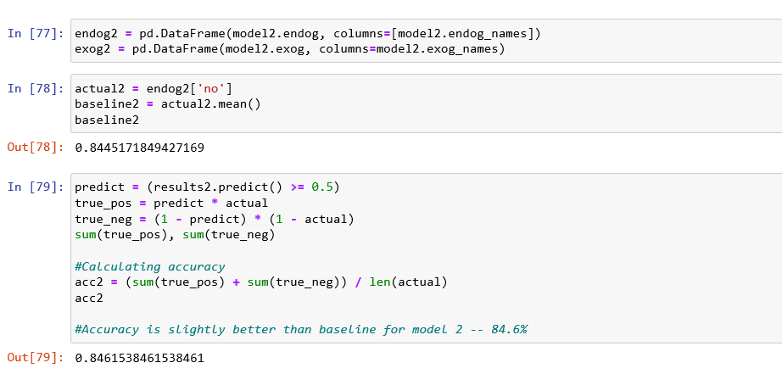
Logistic Regression Results Cont.
Logistic Regression - Attrition as the dependent variable (Binary: Yes or No)

Slide 25
THANK YOU

